Slide 1

Time Series Analysis and Forecasting in Healthcare Research
Dr. Biji C. L. , Associate Professor, VIT Vellore

Slide 2
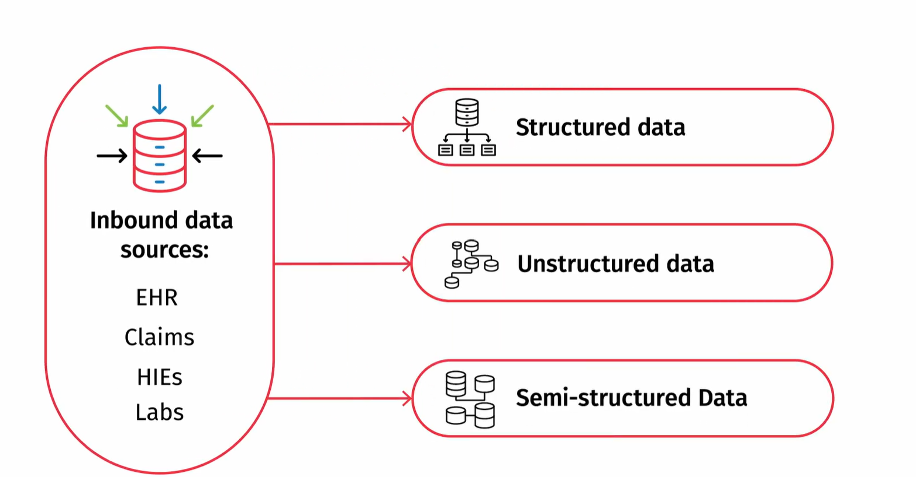

Unlocking the Power of Data
How to transform messy, complex data into a powerful asset for better patient outcomes and analytics.

Slide 3
Time Series Analysis in Healthcare
Time series analysis involves analyzing data collected at regular intervals over time to identify patterns, trends, and dependencies.
By understanding the underlying temporal dynamics, healthcare professionals can gain valuable insights to make informed decisions and predictions.

Slide 4
Time series modeling
Time series modeling is the use of machine learning algorithms and statistical methods to analyse data points that change over a time period.

Slide 5
What is Time series data?
Time series data is a collection of observations recorded sequentially over time.
Disease surveillance data (e.g., weekly malaria cases in a district).
Hospital admissions records (e.g., monthly trends in emergency visits).

Slide 6
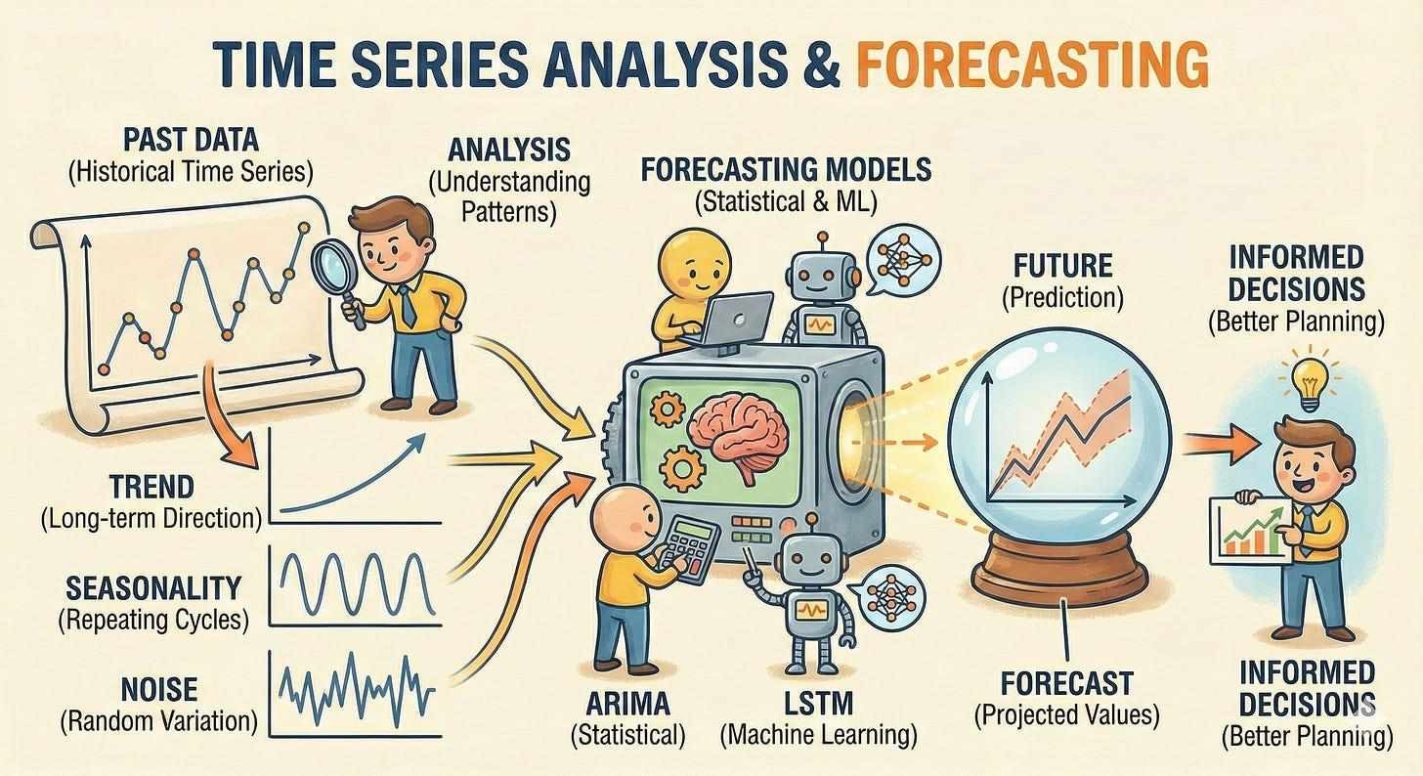
Time Series Analysis & Forecasting is the process of using historical data collected over time to predict future values.

Slide 7
Essential time series components
Time series analysis involves examining a sequence of data points collected over time to uncover hidden patterns.
By analysing historical data, we can identify underlying components such as long-term trends, repeating seasonal cycles, and random fluctuations (noise).

Slide 8
1. Trend (the long-term direction of data)
A trend represents the overall direction in which data is moving over time.
In health research, trends can reveal critical insights for example
A rising trend in diabetes prevalence over decades may indicate worsening lifestyle habits.
A declining trend in maternal mortality rates over time might suggest improvements in healthcare interventions.

Slide 9
2. Seasonality (repeating patterns at fixed intervals)
Seasonality refers to patterns that occur at regular intervals due to predictable external factors. In health data, seasonal variations are common for example;
Influenza cases spike during colder months.
Allergy related hospital visits increase in the spring.
Malaria transmission follows rainfall patterns in endemic regions.
Ignoring seasonality can lead to misleading conclusions.
For example, a researcher analysing malaria data without accounting for seasonality might incorrectly assume an intervention failed, when in reality, the drop in cases was due to the dry season.

Slide 10
3. Cyclic patterns (fluctuations without a fixed interval)
Cyclic patterns are similar to seasonality but do not follow a strict calendar based repetition. Instead, they occur due to long term economic, social, or epidemiological factors for example;
The re-emergence of diseases like measles due to declining vaccination rates can follow a cyclic pattern.

Slide 11
4. Random noise (unpredictable variations in data)
Even the best time series models will encounter random noise, which represents unpredictable fluctuations in data. Noise can result from:
Errors in data collection (e.g., misreported patient symptoms).
The goal of time series analysis is to separate meaningful patterns (trend, seasonality, cycles) from random noise to make informed decisions.

Slide 12
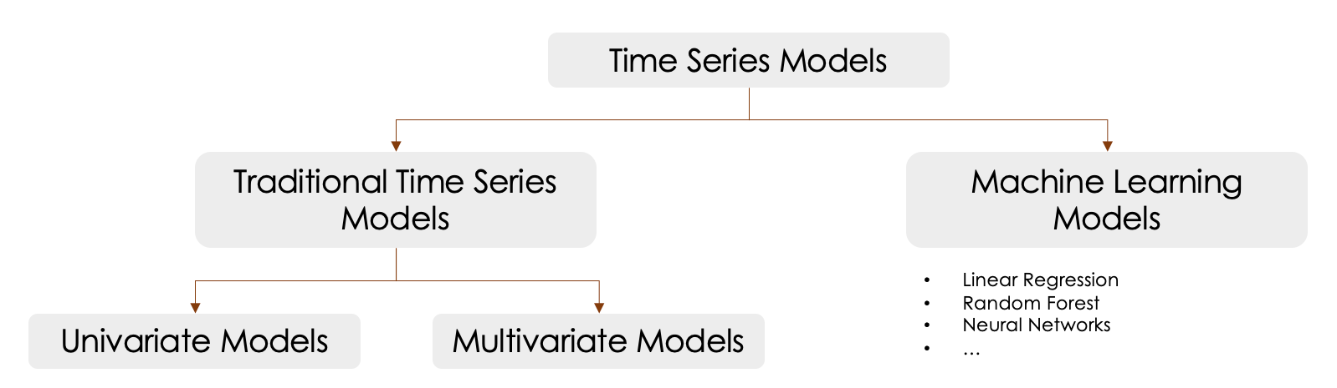
Time series modeling
The use of machine learning algorithms and statistical methods to analyse data points that change over a time period.

Slide 13
Univariate time series analysis
It focuses on the evolution of a single variable over time.
A time series' future values are predicted using this technique based on its historical trends.

Slide 14
Multivariate analysis
To identify how multiple variables (temperature, rainfall, humidity, wind speed) collectively influence disease transmission

Slide 15
Machine learning (ML)
Time series forecasting with the ability to find complex patterns and relationships within data

Slide 16
Hands on With Dengue Data
Disease transmission is strongly influenced by seasonal patterns and climatic variability.
Temperature, rainfall, and humidity drive dengue transmission by affecting mosquito survival, breeding, and viral replication rates. Warmer temperatures (28-32°C) and moderate rainfall create optimal conditions for Aedes mosquitoes, leading to increased disease incidence, while extreme conditions suppress transmission.
Time series modeling will provide actionable insights!

Slide 17
Dataset
Dengue Dataset of Bangladesh – Dhaka Region (2020-2021), created by Dr. Md Rezaul Karim from Directorate General of Health Services Bangladesh

Slide 18
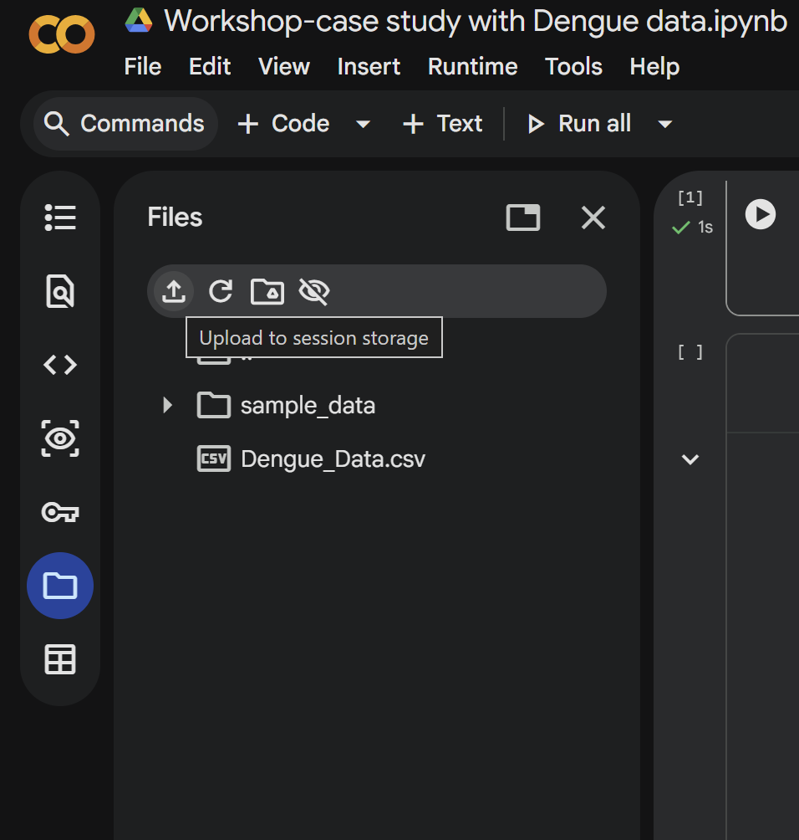

Slide 19
Scope of Analysis
To investigate the quantitative relationship between climatic factors (rainfall, temperature, humidity, wind speed) and dengue incidence in Dhaka, Bangladesh, using time series modeling techniques to identify predictive patterns.

Slide 20
Variables Under Consideration
Date - Daily records from 2020-2021
Month - Month of the record
Case - Daily dengue cases (from DGHS)
Rainfall - Precipitation in mm (from timeanddate.com)
Temperature - Temperature in °C (from timeanddate.com)
Humidity - Humidity in % (from timeanddate.com)
Wind - Wind speed in km/h (from timeanddate.com)

